Slide 1
IS204
System Analysis and Design
System Development
Approaches
COMPUTER INFORMATION SYSTEM DEPARTMENT ASS.LEC. ZAINAB H. ALFAYEZ

Slide 2
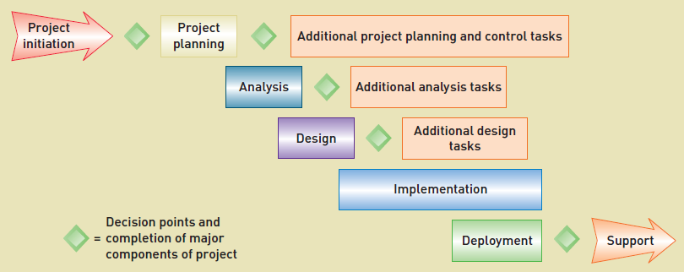
Overlap of System Development Phases
What are the reasons of phases overlap?
COMPUTER INFORMATION SYSTEM DEPARTMENT ASS.LEC. ZAINAB H. ALFAYEZ

Slide 3
Adaptive Approaches to the SDLC
Project activities including plans and models are adjusted as the project progresses.
Include iterations rather than having the analysis, design, and implementation phases proceed sequentially.
Iterations can be used to create a series of mini-projects that address smaller parts of the application.
Using iterations…..
The project is able to adapt to any changes as it proceeds.
Parts of the system are available early on for user evaluation and feedback, which helps ensure that the application will meet the needs of the users.
COMPUTER INFORMATION SYSTEM DEPARTMENT ASS.LEC. ZAINAB H. ALFAYEZ

Slide 4
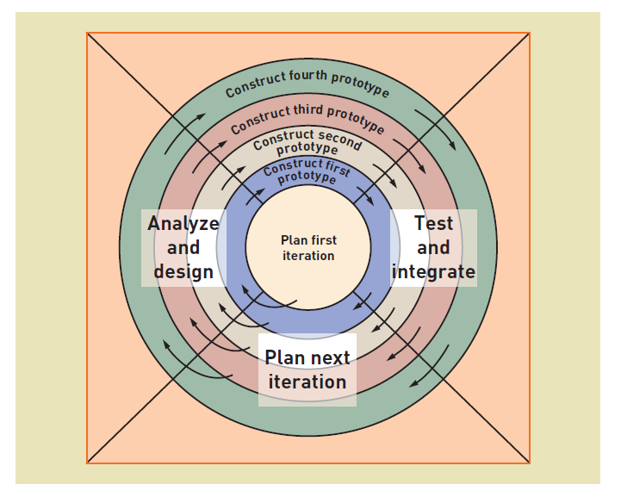
Spiral Model
COMPUTER INFORMATION SYSTEM DEPARTMENT ASS.LEC. ZAINAB H. ALFAYEZ

Slide 5
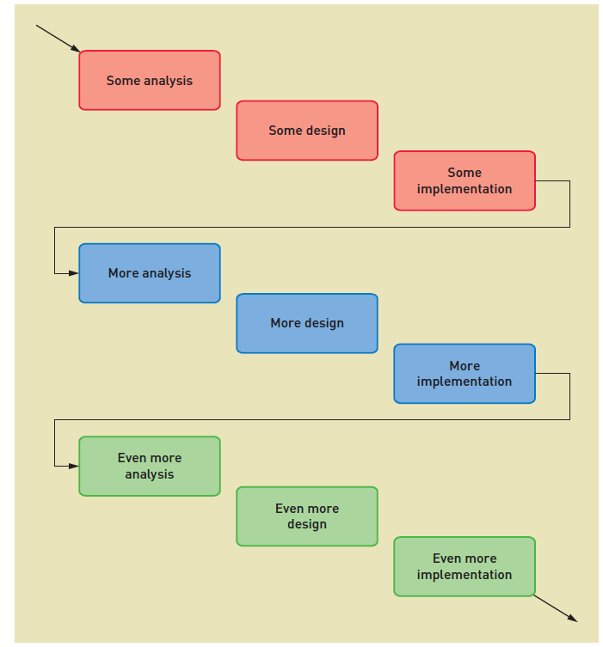
The iteration of system development activities
COMPUTER INFORMATION SYSTEM DEPARTMENT ASS.LEC. ZAINAB H. ALFAYEZ

Slide 6
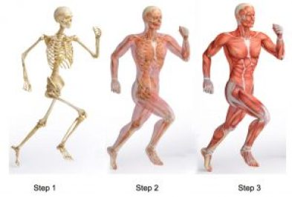
Additional Adaptive Concepts
Incremental Development
The basic idea is the system is built in small increments.
An increment may be developed within a single iteration or it may require two or three iterations. As each increment is completed, it is integrated with the whole.
The advantage of this approach is that portions of the system get into the users’ hands much sooner so the business can begin accruing benefits as early as possible.
Walking Skeleton
An approach in which the complete system structure
is built early, but with bare-bones functionality
COMPUTER INFORMATION SYSTEM DEPARTMENT ASS.LEC. ZAINAB H. ALFAYEZ

